Slide 1

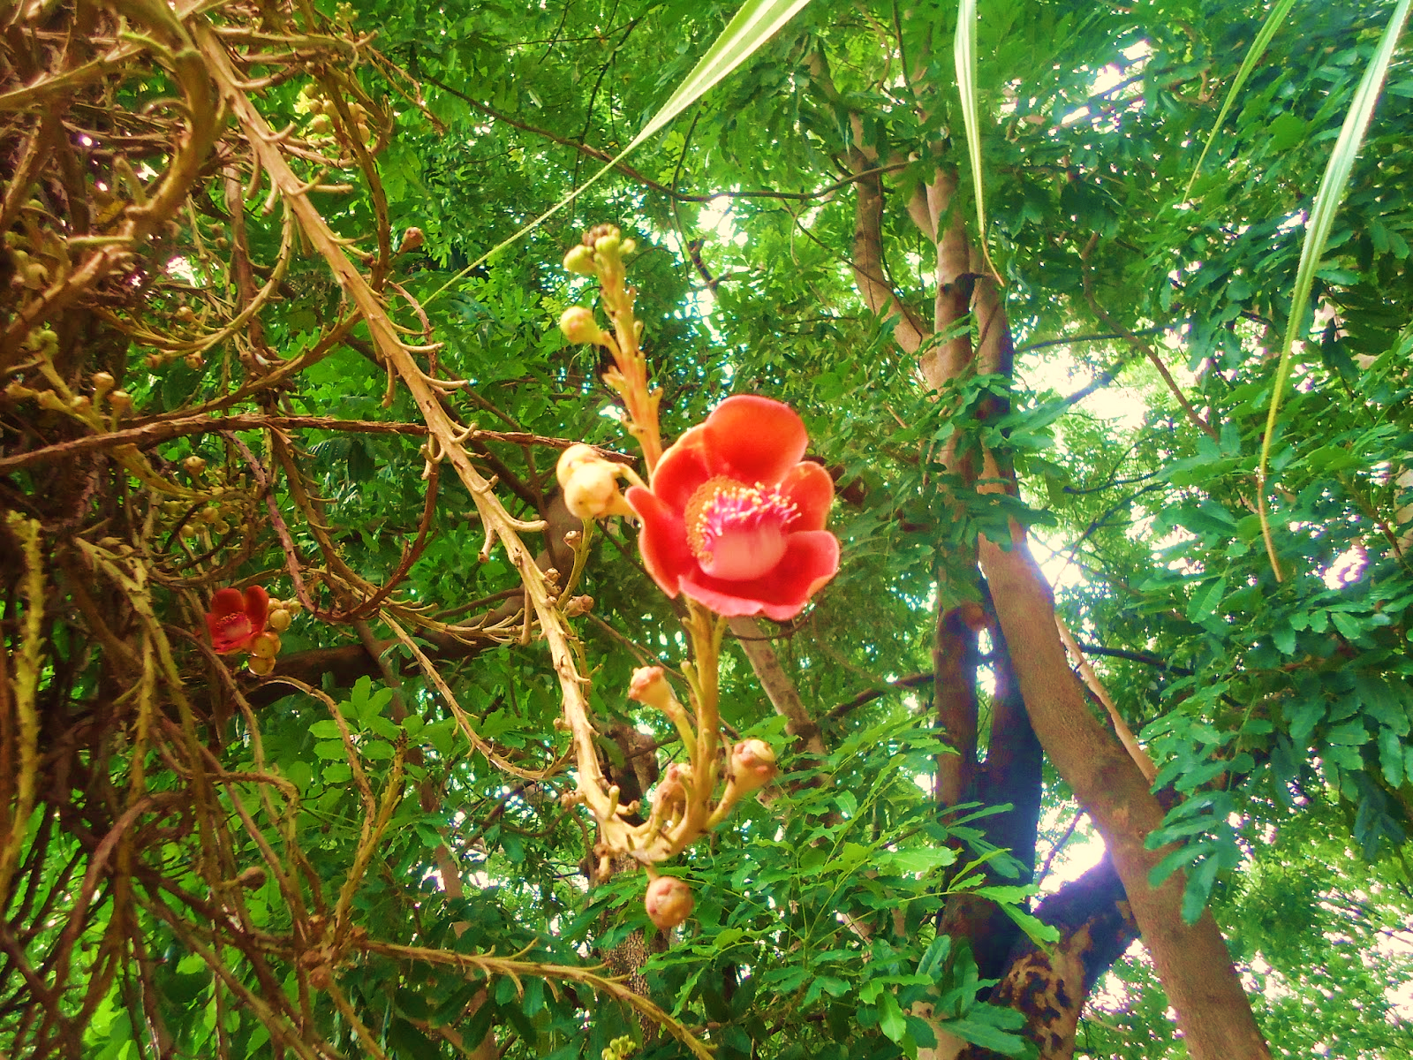
Kailaspati
3
This Photo by Unknown Author is licensed under CC BY-ND

Slide 2
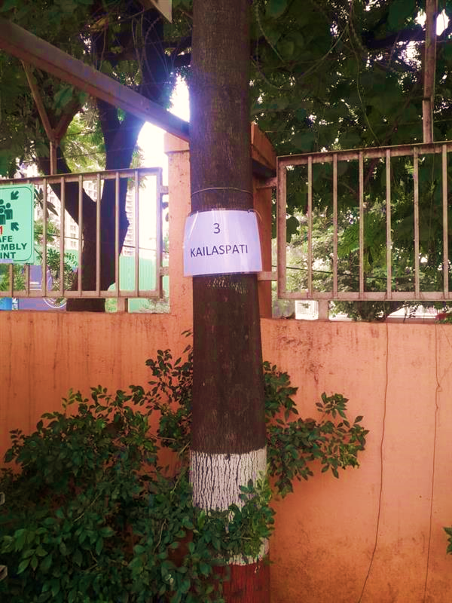
In between Gate no.1 and Gate no.2

Slide 3
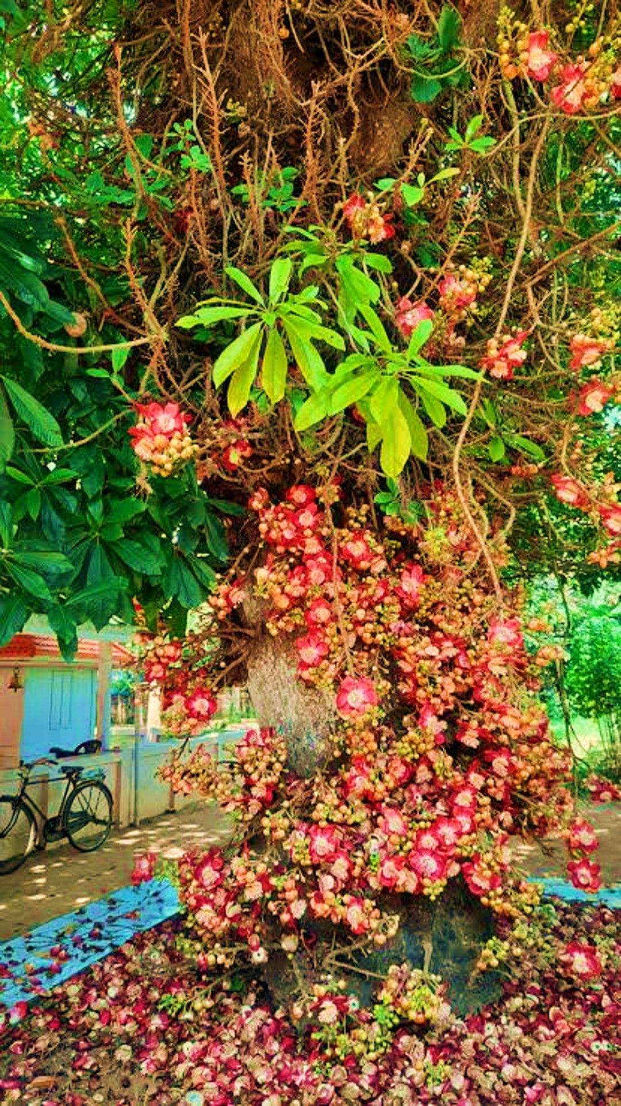

Images

Slide 4
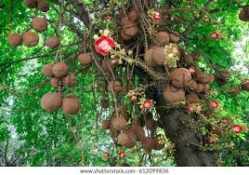

Kailaspati
Near main Gate no.1 –AIS campus Wakad.

Slide 5
Common name: Cannon ball tree
Scientific Name: Couroupita Guianensis
Family: Lecythidaceae
Habit:Species is semi-deciduous, shedding its leaves around once to twice a year, usually in response to dry weather; Flowers-Complex nectar less structures, each consisting of 6 large and fleshy-waxy petals, a disk of numerous short and yellow arranged around reduced styles and stamens, and a pink-white anemone-like structure of hood-stamens.
Distribution:It is native to the tropical forests of Central and South America, and it is cultivated in many other tropical areas throughout the world and the tree has cultural and religious significance in South and Southeast Asia.

Slide 6
Description
Couroupita guianensis is a tree that reaches heights of up to 35 m (110 ft).The leaves, which occur in clusters at the ends of branches, are usually 8 to 31 centimetres (3 to 12 inches) long, but can reach lengths of up to 57 cm (22 in).
The flowers are borne in racemes up to 80 cm (31 in) long formed directly from the tree's trunk. They are considered an extreme example of cauliflory named flagelliflory. Some trees flower profusely until the entire trunk is covered with racemes. One tree can hold as many as 1000 flowers per day.
The fruits are spherical with a woody shell and reach diameters of up to 25 cm (9.8 in), giving the species the common name "cannonball tree". Smaller fruits may contain about 65 seeds, while large ones can hold as many as 550.
While the tree is not native to Asia, having only been introduced there in the last 300 years, its identity has been conflated with other trees mentioned in Hindu and Buddhist scripture, especially the Sal tree.

Slide 7
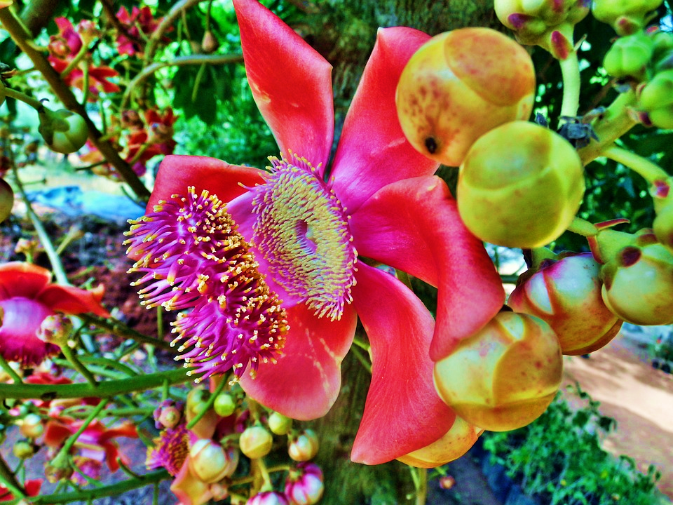
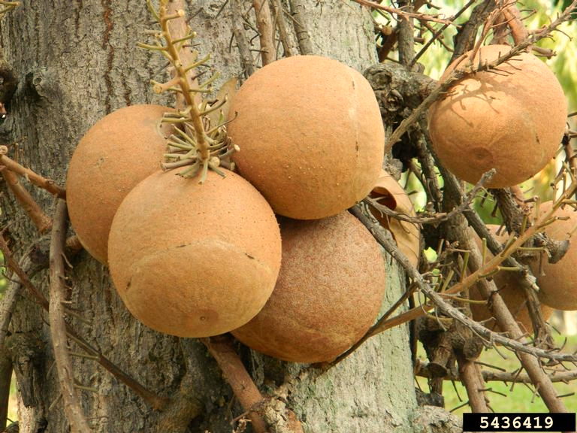

Slide 8
USES :
There are many medicinal uses for the plant. Native Amazonians use extracts of several parts of the tree to treat hypertension, tumors, pain, and inflammation.
It has been used to treat the common cold, stomachache, skin conditions and wounds, malaria, and toothache.
This tree is planted as an ornamental for its showy, scented flowers, and as a botanical specimen for its interesting fruit.
The fruit is fed to livestock such as pigs and domestic fowl.
The fruit is edible, but not usually eaten by people because it can have an unpleasant smell.
In India the tree is sacred to Hindus, who believe its hooded flowers look like the nāga, and it is grown at Shiva temples.

